Slide 1
Manufacturing Technology
13/02/2018 (ME461)
Instructor: Shantanu Bhattacharya

Slide 2

Canned Cycles
Some sequences of machining operations are used so frequently with the different machines and different components that they have a standardized and assigned special preparatory functions. For example a simple hole drilling operation involves the following sequence of operations:
Position the tool just above the point where the hole is to be drilled.
Set the correct spindle speed.
Feed the tool into the workpiece at a controlled feed rate to a predetermined depth.
Retract the tool at a rapid rate to just above the point where the hole started.
The same sequence of operations is repeated for any simple drilling operation regardless of the machine used. The sequence of operations would require several blocks of code if each motion were programmed individually.
However, a special drilling cycle code (G81) has been developed. By using the G81 preparatory function, the programmer achieves the same effect in only one block.
The location and depth of the hole to be drilled, speed and feed to be used, and height above the part surface for positioning before and after drilling are all specified in the block.

Slide 3
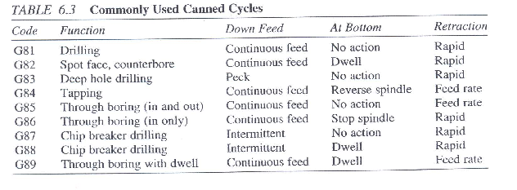
List of Canned Cycles
The effect of any one of these canned cycles is cancelled by programming a G80 function.

Slide 4
Axis Motion Commands
Axis motion commands are used to specify the axes that are required to move during the execution of a given command.
They are made up of a letter specifying an axis such as x, followed by dimensional information associated with the motion of the axis in question.
The X,Y, and Z commands, respectively, specify the motion of the cartesian coordinates themselves; I,J and K values specify the offset relative to x,y,and z axes.
Some controllers support the use of polar coordinates, in which case R and A axes are used to specify the radial and angular directions, respectively.
The dimensional data associated with an axis command can represent absolute dimensions (if G90 was specified) or they may be incremental values (if G91 was specified)
The dimensional data associated with the axis commands consists of real numbers that may or may not have a sign associated with them.
An important point to remember is that the axis commands guide the motion of the point defining the tool position. For some operations, such as profile milling, the periphery of the cutter moves along the surface to be machined, rather than the tool-point (i.e., center of the cutter)

Slide 5
Axis motion commands
Thus the actual motion of the tool has to be along a path different from the geometry of the machined surface. This difference is called a tool offset which the programmer has to consider when writing the program.
Most modern controllers can be programmed using an offset tool by applying a compensation factor called cutter compensation.
With this approach one the offset between the tool point and the machined surface is specified, the tool motion can be programmed as if the tool point followed the actual machined surface.
The controller adjusts internally for the difference in the actual path followed by the tool point.
Cutter compensation is programmed using G41 and G42 codes and cancelled using G40 code.

Slide 6
Feed and speed commands
Feed and speed commands are used to specify the feed rate and speed to use during the machining operation.
The feed command is specified by the address script ‘F’ followed by the numerical value of the feed rate required; the speed command is specified by the address word ‘S’ followed by the required speed.
The feed rate and the speed used during the machining are of crucial importance in determining how long it will take to make a part.
The units for cutting conditions can be specified in a variety of ways in the NC program. The feed rate may be specified directly in units/ min. or units/rev., where the units may be in inches or millimeters.
The preparatory functions G92-G98 are used to designate how the cutting conditions are to be specified.

Slide 7
Identification commands
Identification commands are used within a NC program for the simple task of being able to identify certain entities within the program.
The ‘N’ word is the most widely used identification command and it is used to identify individual blocks within the program.
The identification data in this case consist of integer numbers written in a format given as part of the machine specification.
Usually three or four digits are used and leading or trailing zeros are not suppressed.
The ‘N’ word is purely for the convenience of human writing or using the program, so that they can distinguish between the various blocks in the program.
The MCU itself does not use the data contained in the ‘N’ word.
Because the controller does not use the block identification data, it is not strictly necessary to number the blocks in any particular order.
However, for the convenience of the human users, blocks are generally numbered in ascending order, with increments of 5 or 10 between consecutive blocks.
The reason for having increments of 5 or 10 is that, when necessary, additional blocks may be inserted in the program while maintaining the generally ascending order in which blocks are numbered.

Slide 8
Identification Commands
The other widely used command is the ‘T’ word.
This is used to identify individual cutting tools used within the program.
For most components, more than one tool is needed to complete the machining operations needed to make the part.
For many NC machines, multi-station tool turret or tool magazines housing several cutting tools are used.
The programmer uses the ‘T’ word to specify to the controller regarding the various tools available should be used for a particular machining operation.
The format of ‘T’ word usually consists of two unsigned digits after ‘T’.
Other identification commands are used to identify special sections of the part program, such as loops and macros, that can be executed more than once during the running of the program.

Slide 9
Miscellaneous Commands
Miscellaneous commands are used to control a variety of machine functions that are not covered by the other commands.
The address word ‘M’ followed by two unsigned digits is used to specify miscellaneous commands.
Examples of functions controlled by miscellaneous commands are turning the spindle on and off, turning coolant on and off, initiating a tool change, clamping and unclamping the work-piece interrupting and restarting program execution, stopping the program and rewinding the program.

Slide 10
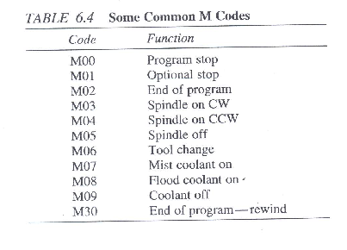
Miscellaneous Commands
Generally, miscellaneous commands take effect after execution of the other commands in the block in which they are programmed.
It is usually permissible to program more than one miscellaneous command in a given block provided they do not have conflicting effects.
Many of the ‘M’ codes have been assigned standardized functions. Some ‘M’ codes are given in the table :

Slide 11
Special Characters
In addition to the commands outlined in the preceding pages, certain special characters are used in NC part programs to achieve special effects.
Some of these special characters are used with all controllers, but others are particular to specific controllers.
These characters include the % sign, common to all controllers, which is used as the first line of the NC program.
The character signals the controller when the beginning of the program has been reached during a rewind of the program, an end of block character is used at the end of each block of the program.
This special character is produced by hit of a carriage return on a keyboard.
The character itself does not print when the program is printed.
During coding , the end-of-block is frequently represented by * symbol or the letters EOB.

Slide 12
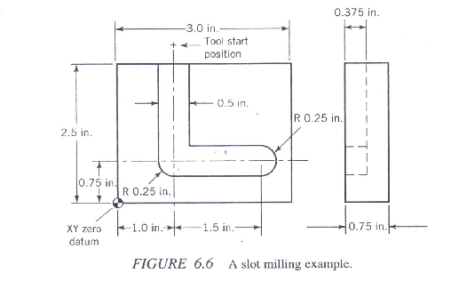
Example of NC code
Write an NC program to machine a ½ in. wide L-shaped slot in a mild steel workpiece with dimensions 3X2.5X0.75 in as shown in Figure:
Assumptions:
The top lower left corner will be used for program zero.
Machining motion will start in the indicated position.
The tool is ¼ in. above the top surface of the part prior to start of machining.
The tool diameter used is ½ in., so only one pass is required.
A cutting speed of 500 rpm and feed rate of 10in./ min are used for machining.
Machine specification: N3G2X + 43Y + 43Z+ 43R+ 43F4S4T2M2

Slide 13
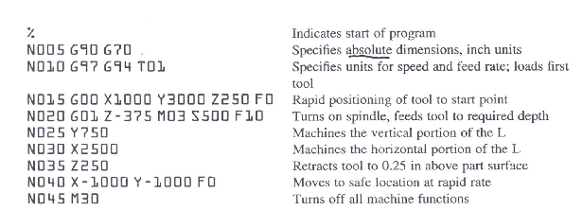
Solution

